Slide 1
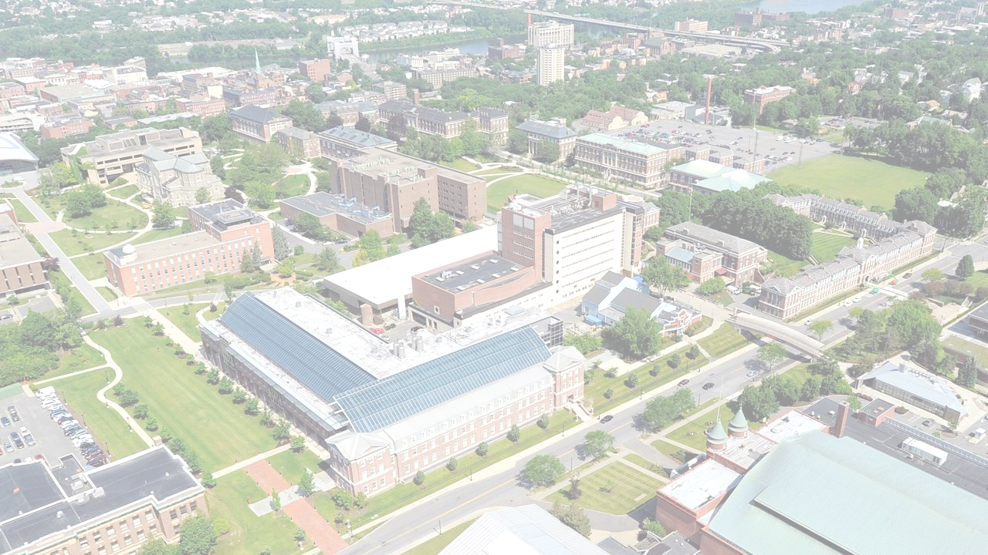


2024 – 200th Birthday of RPI
Political Polarization in Legislative Branches
Presenter: Boleslaw Szymanski
Co-authors: Xiaoyan Lu, Jianxi Gao
NeST Center & SCNARC
Department of Computer Science
Department of Physics, Applied Physics and Astronomy
Rensselaer Polytechnic Institute, Troy, NY 12180
Political Polarization Workshop, Princeton University, August 9. 2019

Slide 2

Introduction
2
Research objective: How does the social and political polarization evolve over time?
Data-driven analysis:
  We collect congress/parliament voting data of the countries including Sweden (2.4M votes), UK (3M votes) and USA (3.5M votes)
Quantifying the social choices of competition and collaboration by mathematical models.
Political Polarization Workshop, Princeton University, August 9. 2019

Slide 3
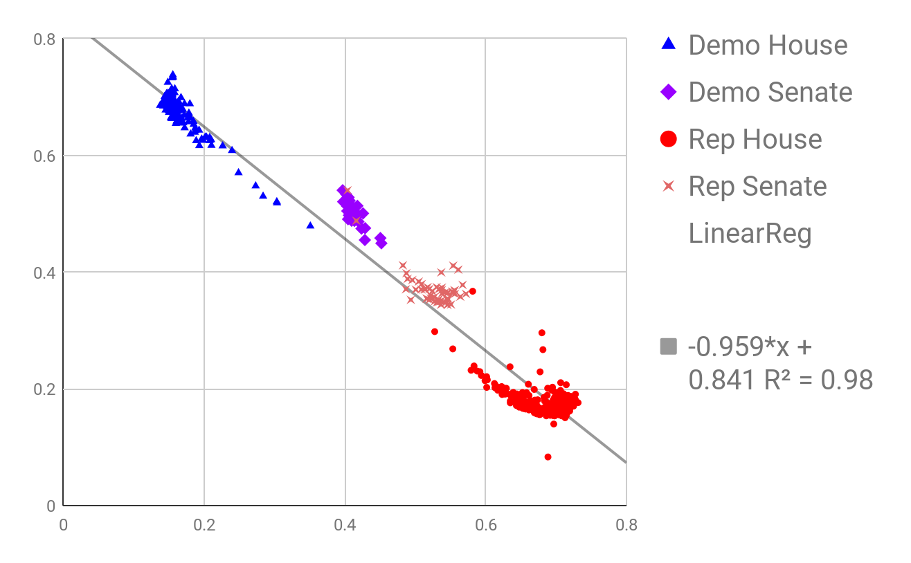




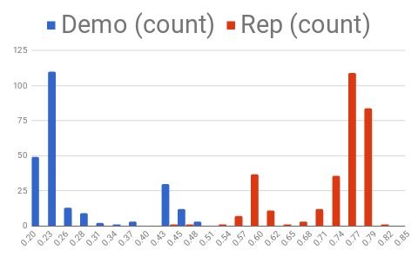
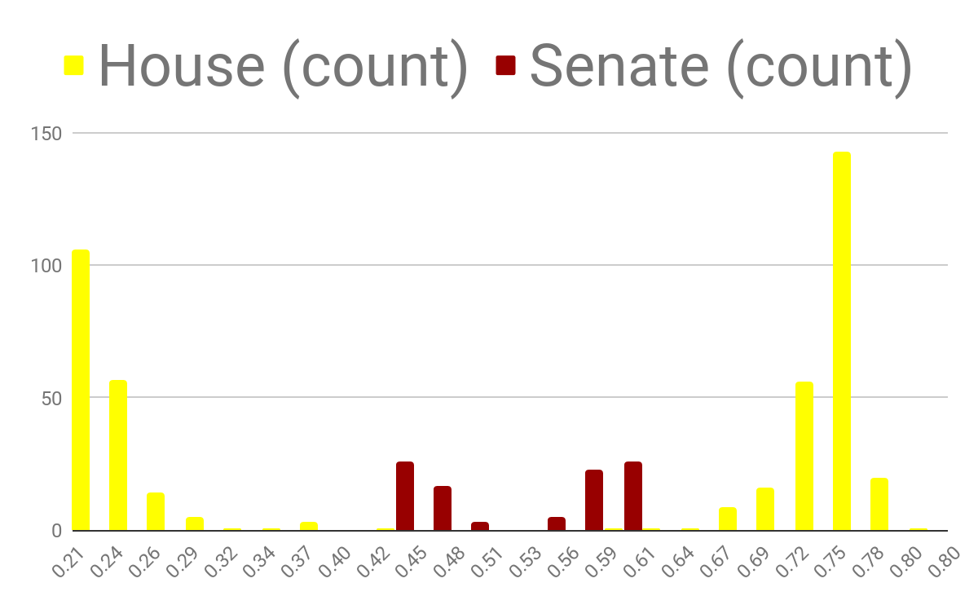
Partisan Alignment of Members of the U.S. Congress (2015)
*Similar results for other countries are in the making
3
Mapping to
(1+x-y)/2
Partisan alignment measured by the distance to a party’s centroid:
is member i’s vote on a bill b among the year 2015’s bills.
Relative measure: if one party deviates then both should move to the poles, but not exactly symmetric due to the non-uniform population distribution.
Members’ loyalty to the party does NOT alway lead to polarization. Parties could align with each other on certain bills themselves.
Mapping to the diagonal, which is equivalent to PCA reducing the dimension from two to one.
Partisan disagreements
If all members agree on all bills
Political Polarization Workshop, Princeton University, August 9. 2019
Notes:
SELECT *, (1+x-y)/2 FROM
(SELECT icpsr, party_code, chamber, AVG(ABS(party_diff100)) x, AVG(ABS(party_diff200)) y
FROM [viral2-146917:USA_vote.bigvote_full]
GROUP BY icpsr, party_code, chamber
ORDER BY party_code, chamber)
1 House House 4218397
2 Senate Senate 873267
3 Senate House 369776
4 House Senate 312237
SELECT sp_chamber, cosp_chamber, COUNT(1) cnt
FROM [viral2-146917:USA_vote.cosponsorship]
WHERE YEAR(date)=2015
GROUP BY sp_chamber, cosp_chamber
ORDER BY cnt DESC

Slide 4
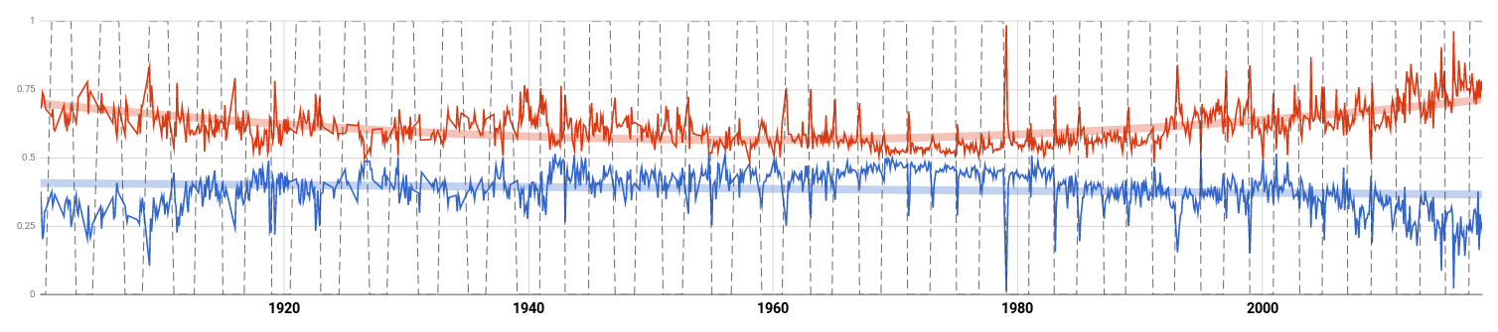
Evolution of the Average Partisan Polarization
4
1900-2018 Monthly
2001-2009
G. W. Bush presidency
1960 Kennedy defeating Nixon
1993-2001 Clinton
presidency
1962 Cuban missile crisis
1929 Great Depression
1963 "I Have a Dream"
2009-2017 Obama presidency
1941 Pearl Harbor
1980 Reagan defeating Carter
Political Polarization Workshop, Princeton University, August 9. 2019
Notes:
SELECT a.yearmonth yearmonth, (1+a.x-a.y)/2 demo, (1+b.x-b.y)/2 rep, INTEGER(FLOOR((a.yearmonth+1)/2))%2
FROM
(SELECT YEAR(date)+(MONTH(date))/12 yearmonth, AVG(party_diff100) x, AVG(party_diff200) y
FROM [viral2-146917:USA_vote2.bigvote_full_1900_2018]
WHERE party_code=100
GROUP BY yearmonth) a
JOIN
(SELECT YEAR(date)+(MONTH(date))/12 yearmonth, AVG(party_diff100) x, AVG(party_diff200) y
FROM [viral2-146917:USA_vote2.bigvote_full_1900_2018]
WHERE party_code=200
GROUP BY yearmonth) b
ON a.yearmonth=b.yearmonth
ORDER BY yearmonth

Slide 5
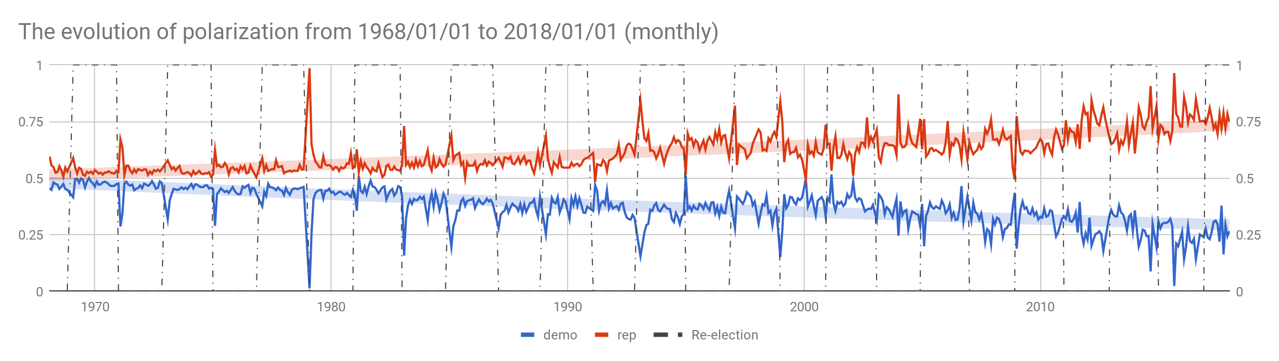
Evolution of the Average Partisan Polarization
5
Polarization increases as a general trend, but it decreases within each congress in the 70s and 80s.
Political Polarization Workshop, Princeton University, August 9. 2019
Notes:
SELECT a.yearmonth yearmonth, (1+a.x-a.y)/2 demo, (1+b.x-b.y)/2 rep, INTEGER(FLOOR((a.yearmonth+1)/2))%2
FROM
(SELECT YEAR(date)+(MONTH(date))/12 yearmonth, AVG(party_diff100) x, AVG(party_diff200) y
FROM [viral2-146917:USA_vote2.bigvote_full_1968_2018]
WHERE party_code=100
GROUP BY yearmonth) a
JOIN
(SELECT YEAR(date)+(MONTH(date))/12 yearmonth, AVG(party_diff100) x, AVG(party_diff200) y
FROM [viral2-146917:USA_vote2.bigvote_full_1968_2018]
WHERE party_code=200
GROUP BY yearmonth) b
ON a.yearmonth=b.yearmonth
ORDER BY yearmonth

Slide 6
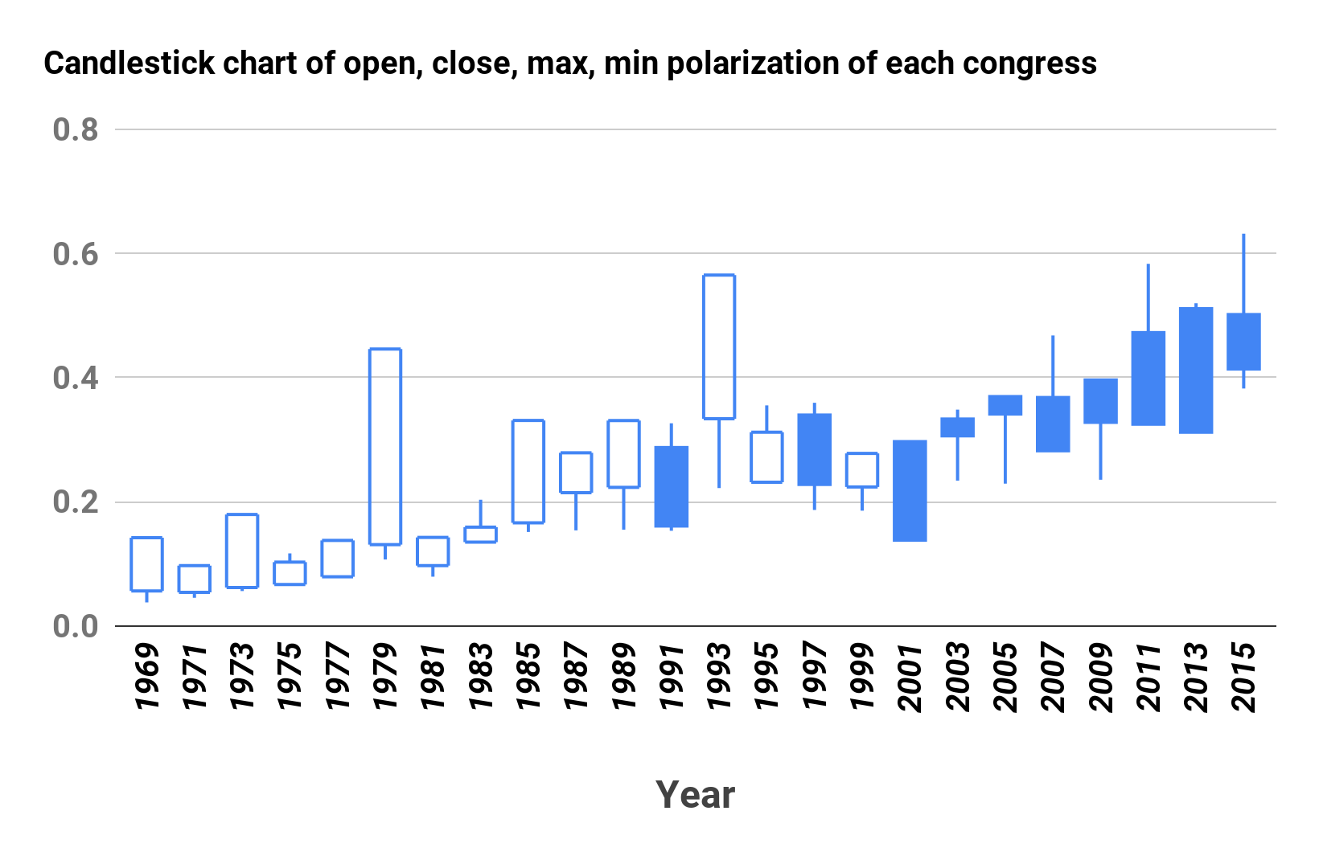
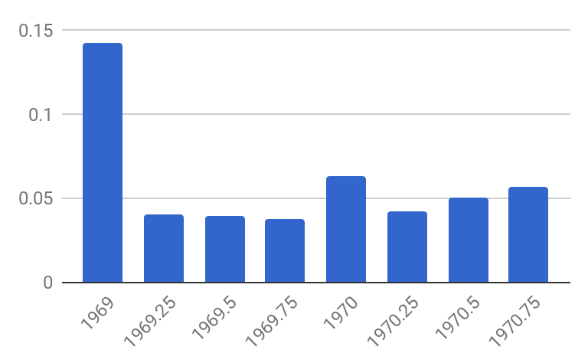
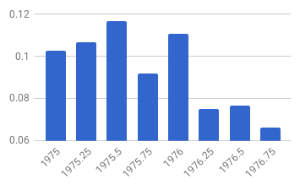
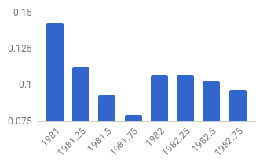
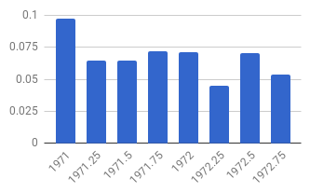
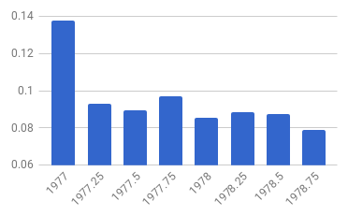
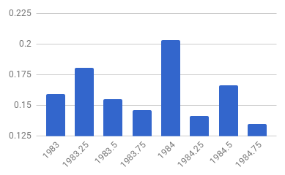
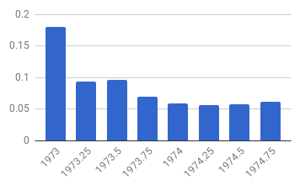
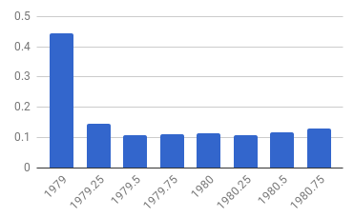
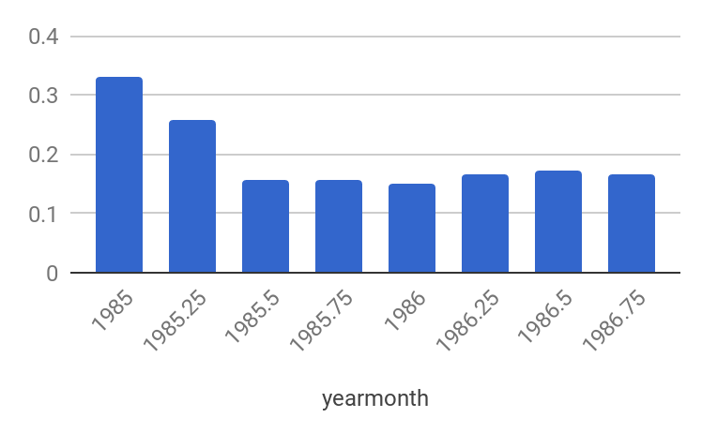
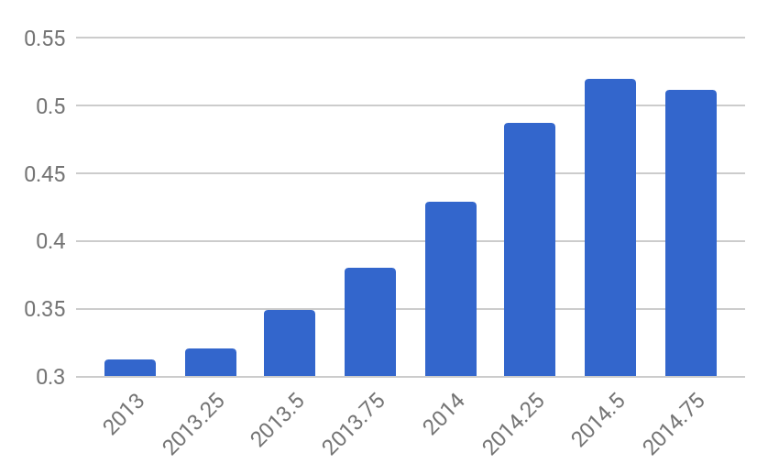
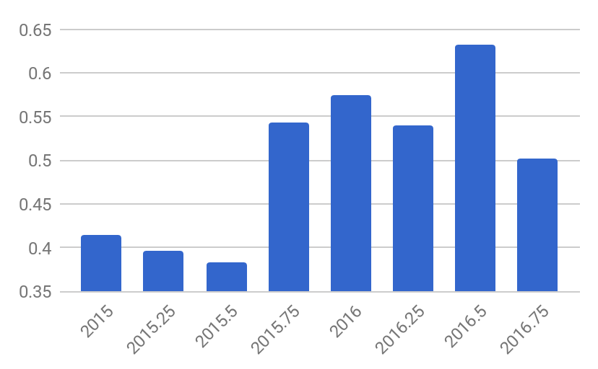
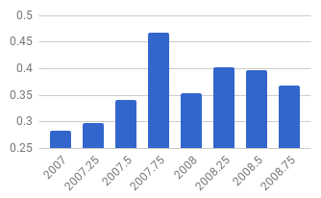
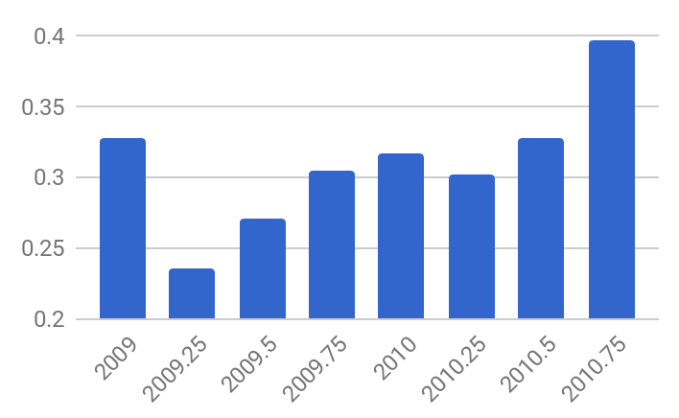
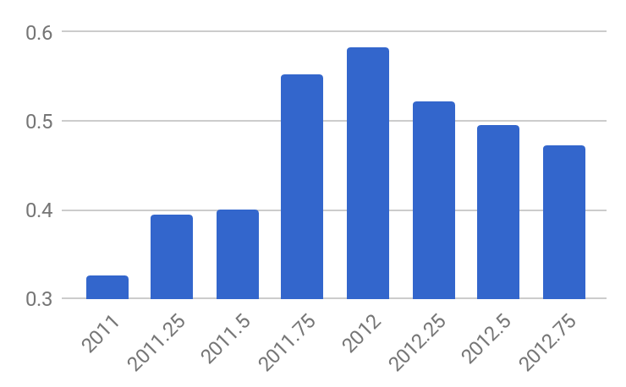
Evolution within Each Congress (2 years term)
6
Period I (1969-1989) Polarization decreases
Period I
Period II
Period III
Period III (2001-2017) Polarization increases (seasonal plot)
Political Polarization Workshop, Princeton University, August 9. 2019
Notes:
SELECT a.yearmonth yearmonth, (1+a.x-a.y)/2 demo, (1+b.x-b.y)/2 rep, ABS((1+a.x-a.y)/2-(1+b.x-b.y)/2) polarization, INTEGER(FLOOR((a.yearmonth+1)/2))%2
FROM
(SELECT YEAR(date)+INTEGER(MONTH(date)/3)/4 yearmonth, AVG(party_diff100) x, AVG(party_diff200) y
FROM [viral2-146917:USA_vote2.bigvote_full_1968_2018]
WHERE party_code=100
GROUP BY yearmonth) a
JOIN
(SELECT YEAR(date)+INTEGER(MONTH(date)/3)/4 yearmonth, AVG(party_diff100) x, AVG(party_diff200) y
FROM [viral2-146917:USA_vote2.bigvote_full_1968_2018]
WHERE party_code=200
GROUP BY yearmonth) b
ON a.yearmonth=b.yearmonth
ORDER BY yearmonth
Save as tableUSA_vote.seasonal_1968 then
SELECT a.idx idx, * FROM
(SELECT INTEGER((yearmonth+1)/2) idx,* FROM [viral2-146917:USA_vote.seasonal_196818] WHERE INTEGER(yearmonth)=yearmonth AND INTEGER(yearmonth)%2=1) a
JOIN
(SELECT INTEGER((yearmonth+1)/2) idx,* FROM [viral2-146917:USA_vote.seasonal_196818] WHERE INTEGER(yearmonth+0.25)=yearmonth+0.25 AND INTEGER(yearmonth+0.25)%2=1) b
ON a.idx=b.idx
ORDER BY idx

Slide 7
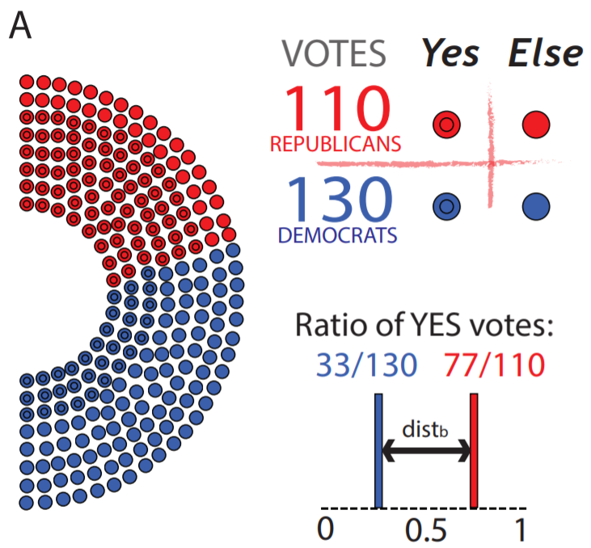
The evolution of polarization in the legislative branch of government
7
We analyze millions of roll-call votes cast in the U.S. Congress over the past six decades to identify evolution of political polarization patterns
Using the roll-call vote results, we quantify the level of polarization in the legislative branch of government over the last six decades
Political Polarization Workshop, Princeton University, August 9. 2019

Slide 8
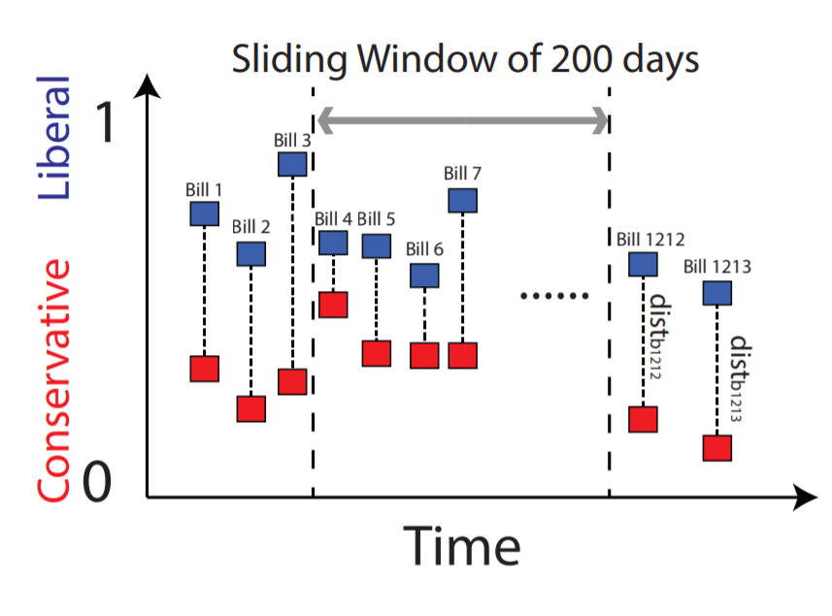
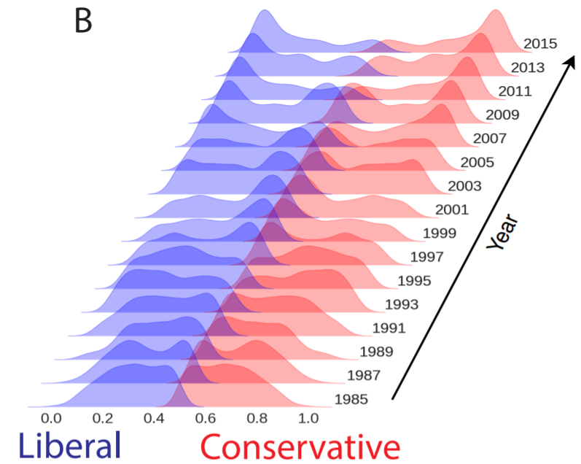
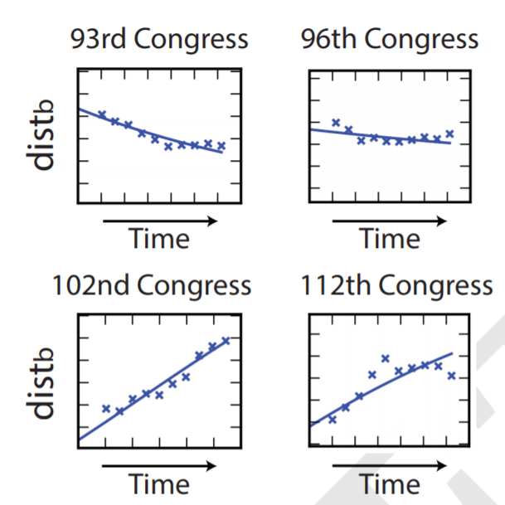
The evolution of polarization in the legislative branch of government
8
Long-term polarization pattern
The political polarization levels at ten evenly-distributed sampled time points exhibit an evolution of polarization patterns from one type of behavior to another

Slide 9





Dynamic Social Competition Model[1]
9
measures the current polarization, so the collaboration is measured by the complementary fraction of x, i.e.
increased competition
lost competition
simple symmetric transition functions:
Impact of population belief on the change of polarization
Perceived utility of competition, (the benefit fighting against the other party on certain bills)
= Evolution speed
[1] Abrams, D. M., & Strogatz, S. H. (2003). Linguistics: Modelling the dynamics of language death. Nature, 424(6951), 900.
Political Polarization Workshop, Princeton University, August 9. 2019
Notes:
SELECT a.idx idx, * FROM
(SELECT INTEGER((yearmonth+1)/2) idx,* FROM [viral2-146917:USA_vote.seasonal_196818] WHERE INTEGER(yearmonth)=yearmonth AND INTEGER(yearmonth)%2=1) a
JOIN
(SELECT INTEGER((yearmonth+1)/2) idx,* FROM [viral2-146917:USA_vote.seasonal_196818] WHERE INTEGER(yearmonth+0.25)=yearmonth+0.25 AND INTEGER(yearmonth+0.25)%2=1) b
ON a.idx=b.idx

Slide 10
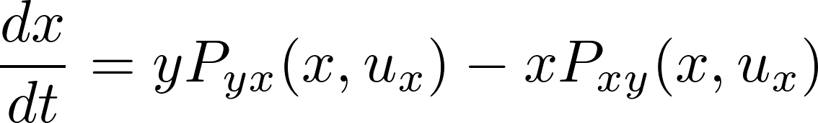
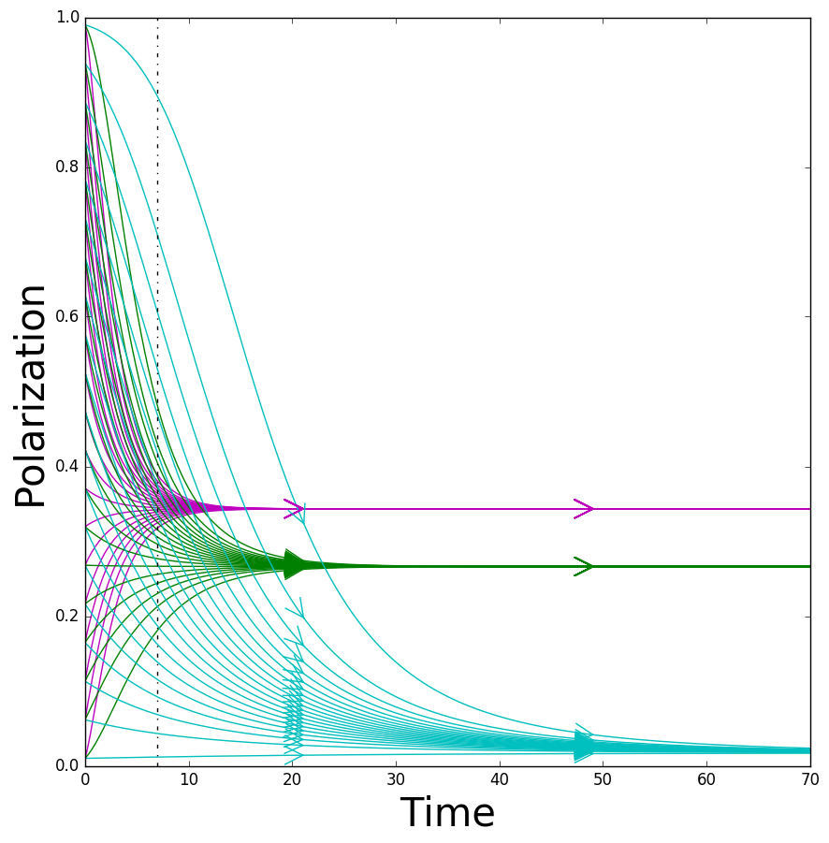
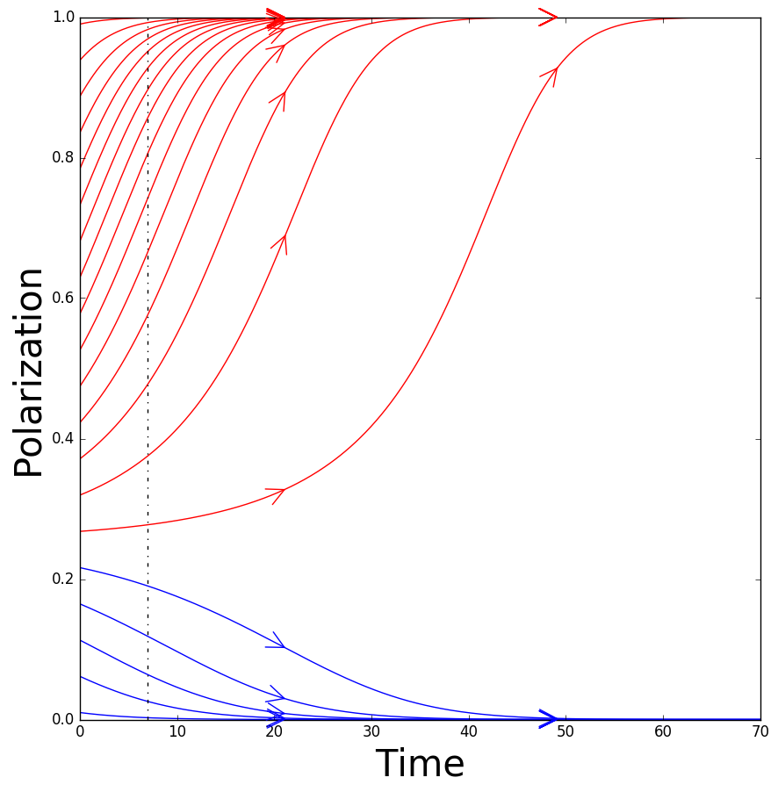
10
Dynamical Model for Polarization Evolution
We assume a social system dominated by two parties. In such a system polarization and collaboration can convert into each other but they maintain their sum constant at 1.
a>1
a<1
Stable system
Unstable system

Slide 11
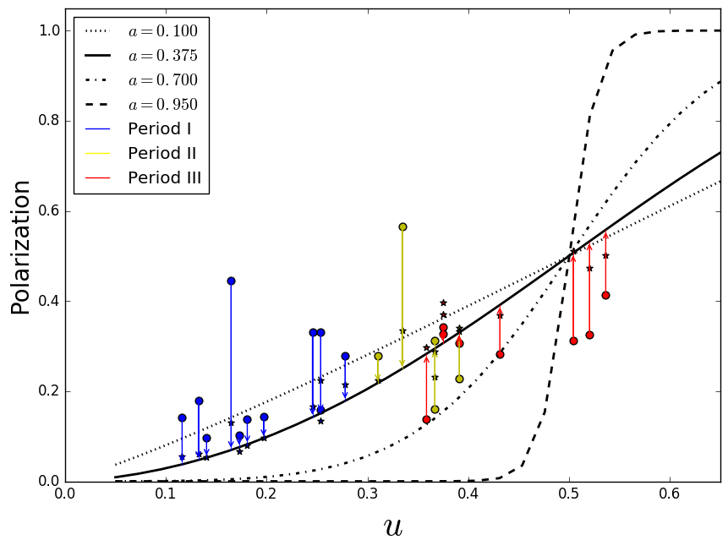
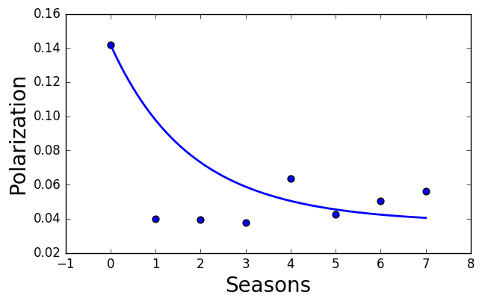
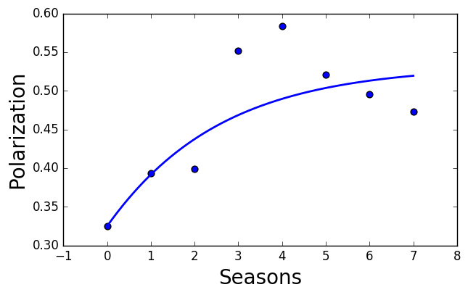

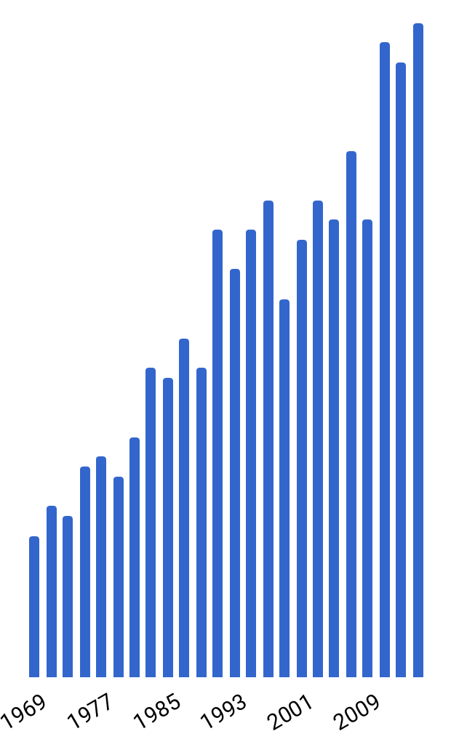


How to Reduce Social Polarization?
The stable states of the dynamical system when < 1 : convergence at some polarization level
We assume that is unique for each congress, but and are universal at all times.
Year 1969
Year 2011
Least Absolute Errors (LAE) estimate:
Utility of competition over time
Notes:
https://journals.aps.org/prl/supplemental/10.1103/PhysRevLett.107.088701/Abrams_SI.pdf

Slide 12
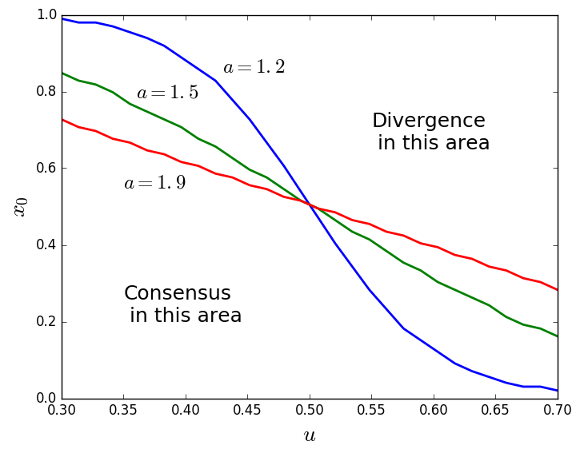

How to Reduce Social Polarization?
The stable states of the dynamical system when > 1 : either consensus or divergence
Unstable system

Slide 13
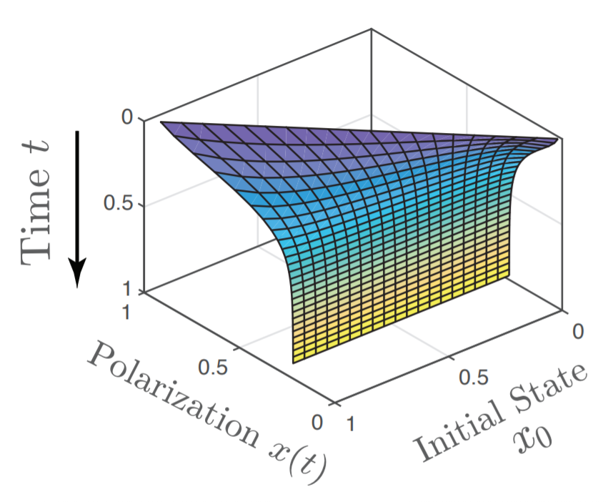
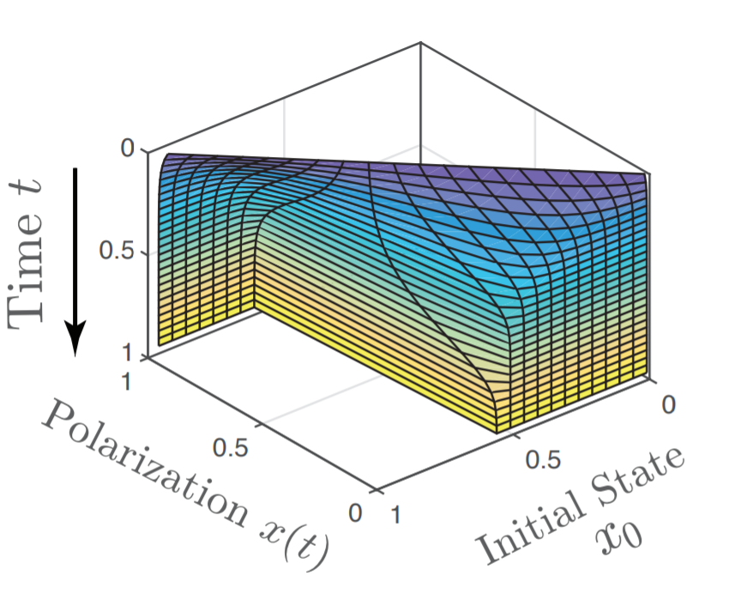
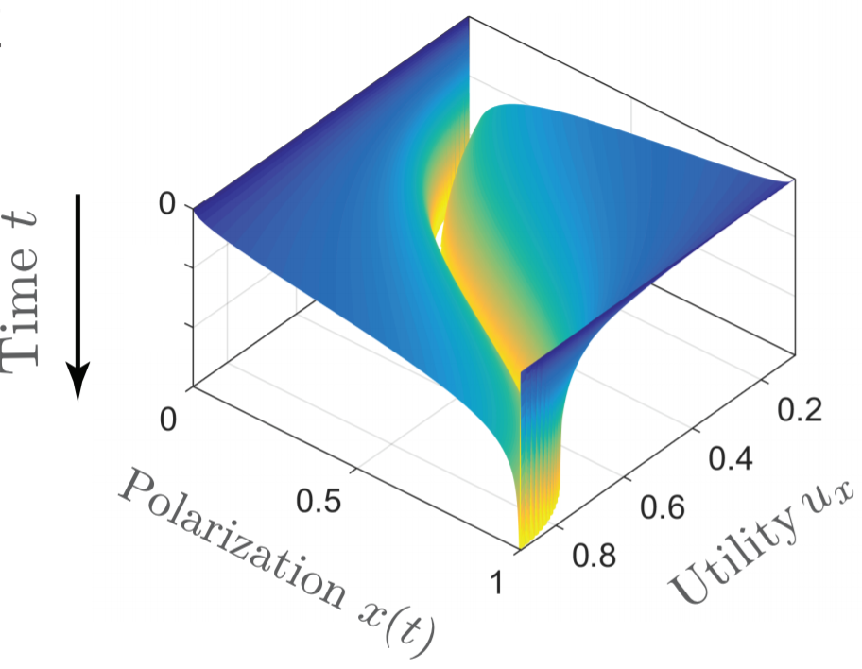
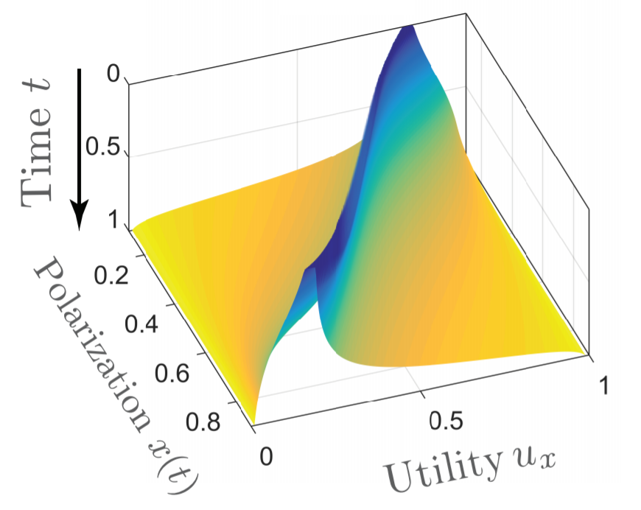
11
Dynamical Model for Polarization Evolution
Stable system:
Unstable system:

Slide 14
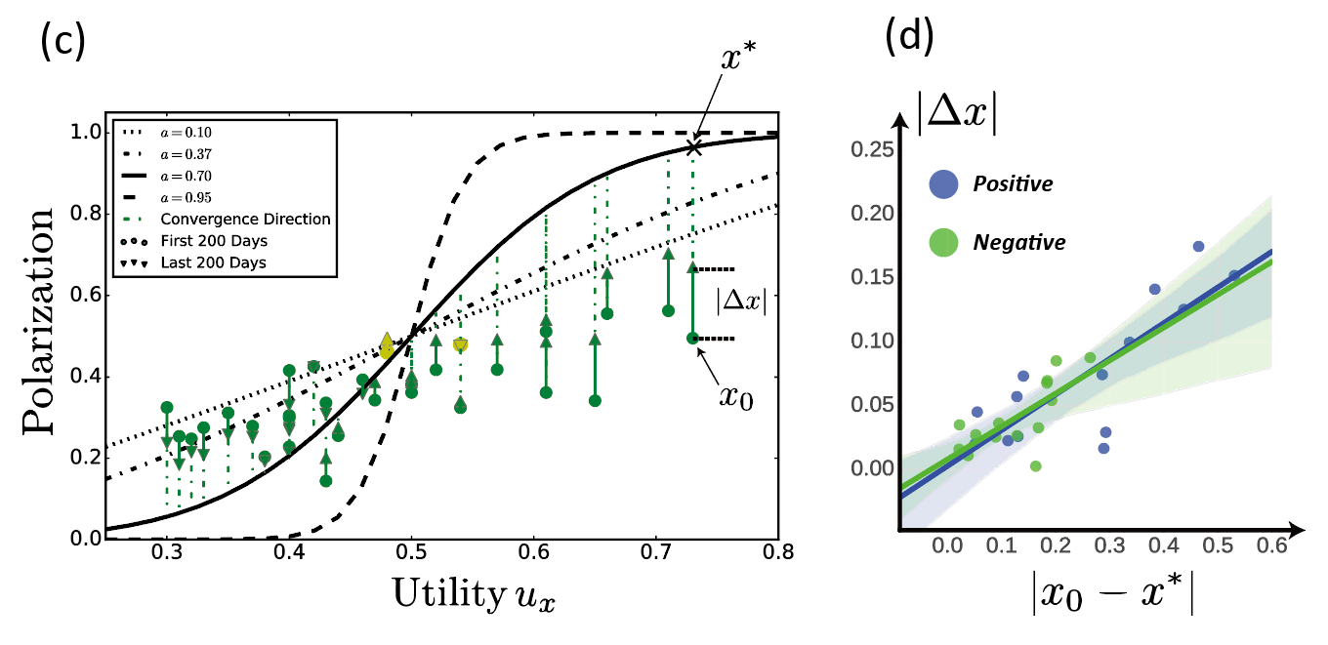
12
Direction of Polarization Change
When the initial polarization level (green cycles) is smaller than the stable polarization level predicted by our model (solid black curve), we observe an increase of polarization within one Congress. The direction of such change in 28 out of all 30 Congresses are explained by the model (green arrows)
Political Polarization Workshop, Princeton University, August 9. 2019

Slide 15
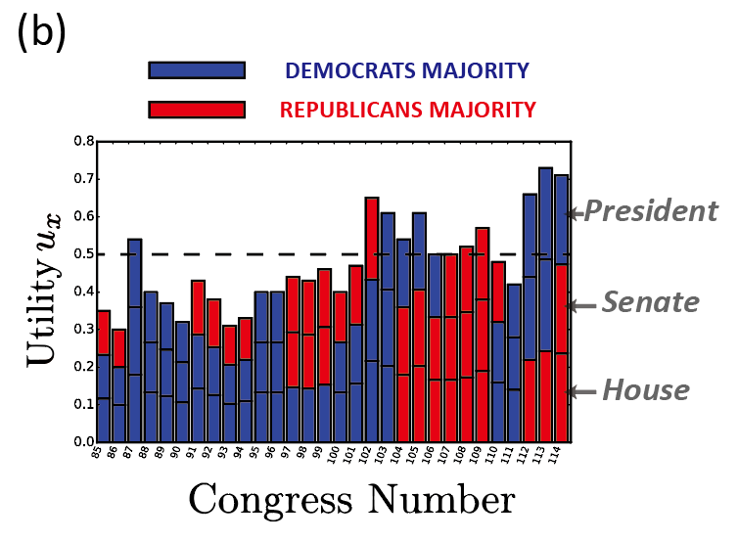
13
Polarization Utility
6 of 14 Presidential election Congresses started with the polarization utilities at least 0.5 while only 1 of 15 midterm election Congresses achieved such high polarization utility
The highest polarization utility growth (57.1%) occurs in the 112th Congress (2011-2013).
  Super PACs arose following the July 2010 federal court decision
Political Polarization Workshop, Princeton University, August 9. 2019
Notes:
3 -> by-product dense or not/ ->

Slide 16
17
Contributions
Theory: We define a dynamical model quantifying the evolution of polarization in the U.S. Congresses elected in the past six decades.
The hidden model parameter, polarization utility, correlates well with significant political or legislative changes happening at the same time.
Algorithm: We implemented a predictor based on the model that successfully predicts the direction of polarization changes in 28 out of 30 elected U.S. Congresses.
The hidden model parameter, polarization utility, correlates well with significant political or legislative changes happening at the same time.
Political Polarization Workshop, Princeton University, August 9. 2019
Notes:
3 -> by-product dense or not/ ->

Slide 17
18
Thanks
Questions?
Reference:
X. Lu, J. Gao, B. K. Szymanski, “The evolution of polarization in the legislative branch of government,” Royal Society Interface, 16:20190010, 2019
Political Polarization Workshop, Princeton University, August 9. 2019

